Slide 1

Shared Counters and Parallelism
Companion slides for
The Art of Multiprocessor Programming
by Maurice Herlihy, Nir Shavit, Victor Luchangco, and Michael Spear
TexPoint fonts used in EMF.
Read the TexPoint manual before you delete this box.: AAAA
Notes:
1

Slide 2
A Shared Pool
Put
  Insert item
  block if full
Remove
  Remove & return item
  block if empty
public interface Pool<T> {
public void put(T x);
public T remove();
}
Art of Multiprocessor Programming
2
Notes:
2
A pool is a set of objects. The pool interface provides Put() and Remove() methods that respectively insert and remove items from the pool. Familiar classes such as stacks and queues can be viewed as pools that provide additional ordering guarantees.

Slide 3
Simple Locking Implementation
put
put
Notes:
One natural way to implement a shared pool is to have each method lock the pool, perhaps by making both Put() and Remove() synchronized methods.

Slide 4
Simple Locking Implementation
put
put
Problem: hot-spot contention
4
Notes:
4
The problem, of course, is that such an approach is too heavy-handed, because the lock itself would become a hot-spop. We would prefer an implementation in which Pool methods could work in parallel.

Slide 5
Simple Locking Implementation
put
Problem: sequential bottleneck
put
Problem: hot-spot contention
5
Notes:
5
The problem, of course, is that such an approach is too heavy-handed, because the lock itself would become a hot-spop. We would prefer an implementation in which Pool methods could work in parallel.

Slide 6
Simple Locking Implementation
put
Problem: sequential bottleneck
put
Problem: hot-spot contention
Solution: Queue Lock
Art of Multiprocessor Programming
6
Notes:
6
The problem, of course, is that such an approach is too heavy-handed, because the lock itself would become a hot-spop. We would prefer an implementation in which Pool methods could work in parallel.

Slide 7
Simple Locking Implementation
put
Problem: sequential bottleneck
Solution:?
put
Problem: hot-spot contention
Solution: Queue Lock
Art of Multiprocessor Programming
7
Notes:
7
The problem, of course, is that such an approach is too heavy-handed, because the lock itself would become a hot-spop. We would prefer an implementation in which Pool methods could work in parallel.

Slide 8
Counting Implementation
put
19
19
20
remove
20
21
21
Notes:
Consider the following alternative. The pool itself is an array of items, where each array element either contains an item, or is \Jnull. We route threads through two GetAndIncrement() counters. Threads calling Put() increment one counter to choose an array index into which the new item should be placed. (If that slot is full, the thread waits until it becomes empty.) Similarly, threads calling Remove() increment another counter to choose an array index from which the new item should be removed. (If that slot is empty, the thread waits until it becomes full.)

Slide 9
Counting Implementation
put
19
19
20
remove
20
21
21
Only the counters are sequential
Notes:
This approach replaces one bottleneck, the lock, with two, the counters. Naturally, two bottlenecks are better than one (think about that claim for a second). But are shared counters necessarily bottlenecks? Can we implement highly-concurrent shared counters?

Slide 10
Shared Counter
0
1
3
2
3
2
1
Notes:
The problem of building a concurrent pool reduces to the problem of building a concurrent counter. But what do we mean by a couner?

Slide 11
Shared Counter
No duplication
0
1
3
2
3
2
1
Notes:
Well, first, we want to be sure that two threads never take the same value.

Slide 12
Shared Counter
No duplication
No Omission
0
1
3
2
3
2
1
Notes:
Second, we want to make sure that the threads do not collectively skip a value.

Slide 13
Shared Counter
No duplication
No Omission
0
1
3
2
3
2
1
Not necessarily linearizable
Notes:
Finally, we will not insist that counters be linarizable. Later on, we will see that linearizable counters are much more expensive than non-linearizable counters. You get what you pay for, and you pay for what you get.

Slide 14
Shared Counters
Can we build a shared counter with
  Low memory contention, and
  Real parallelism?
Locking
  Can use queue locks to reduce contention
  No help with parallelism issue …
Notes:
We face two challenges.
Can we avoid memory contention, where too many threads try to access the same
memory location, stressing the underlying communication network and cache
coherence protocols?
Can we achieve real parallelism? Is incrementing a counter an inherently sequential operation, or is it possible for $n$ threads to increment a counter in time less than it takes for one thread to increment a counter $n$ times?

Slide 15
Software Combining Tree
4
Contention:
All spinning local
Parallelism:
Potential n/log n speedup
Notes:
A combining tree is a tree of nodes, where each node contains bookkeeping information. The counter's value is stored at the root. Each thread is assigned a leaf, and at most two threads share a leaf. To increment the counter, a thread starts at its leaf, and works its way up the tree to the root. If two threads reach a node at approximately the same time, then they combine their increments by adding them together. One thread, the first thread, propagates their combined increments up the tree, while the other, second thread, waits for the first thread to complete their combined work..

Slide 16
Combining Trees
0
Notes:
Here, the counter is zero, and the blue and yellow processors are about to add to the counter.

Slide 17
Combining Trees
0
+3
Notes:
Blue registers it’s request to add three at its leaf.

Slide 18
Combining Trees
0
+3
+2
Notes:
At about the same time, yellow adds two to the clunters

Slide 19
Combining Trees
0
+3
Two threads meet, combine sums
+2
Notes:
These two requests meet at the shared node, and are combined ..

Slide 20
Combining Trees
0
+5
+3
Two threads meet, combine sums
+2
Notes:
the blue three and the yellow two are combined into a green five

Slide 21
Combining Trees
5
Combined sum added to root
+5
+3
+2
Notes:
These combined requests are added to the root …

Slide 22
Combining Trees
5
Result returned to children
0
+3
+2

Slide 23
Combining Trees
5
0
0
Results returned to threads
0
3
Notes:
Each node remembers enough bookkeeping information to distribute correct results among the callers.

Slide 24
What if?
Art of Multiprocessor Programming
24
Threads don’t arrive together?
  Should I stay or should I go?
How long to wait?
  Waiting times add up …
Idea:
  Use multi-phase algorithm
  Where threads wait in parallel …
Notes:
24

Slide 25
Combining Status
enum CStatus{
IDLE, FIRST, SECOND, RESULT, ROOT
};

Slide 26
Combining Status
enum CStatus{
IDLE, FIRST, SECOND, RESULT, ROOT
};
Nothing going on

Slide 27
Combining Status
enum CStatus{
IDLE, FIRST, SECOND, RESULT, ROOT
};
1st thread is a partner for combining, will return to check for 2nd thread

Slide 28
Combining Status
enum CStatus{
IDLE, FIRST, SECOND, RESULT, ROOT
};
2nd thread has arrived with value for combining

Slide 29
Combining Status
enum CStatus{
IDLE, FIRST, SECOND, RESULT, ROOT
};
1st thread has deposited result for 2nd thread

Slide 30
Combining Status
enum CStatus{
IDLE, FIRST, SECOND, RESULT, ROOT
};
Special case: root node

Slide 31
Node Synchronization
Use “Meta Locking:”
Short-term
  Synchronized methods
  Consistency during method call
Long-term
  Boolean locked field
  Consistency across calls
Notes:
The idea of meta locking is to use short term locks to allow mutually exclusive access to a lock variable that controls longer state locks. This is a useful approach and the one taken for example when implementing the locks used in the “synchronized” calls in Java.

Slide 32
Phases
Precombining
  Set up combining rendez-vous

Slide 33
Phases
Art of Multiprocessor Programming
33
Precombining
  Set up combining rendez-vous
Combining
  Collect and combine operations
Notes:
33

Slide 34
Phases
Art of Multiprocessor Programming
34
Precombining
  Set up combining rendez-vous
Combining
  Collect and combine operations
Operation
  Hand off to higher thread
Notes:
34

Slide 35
Phases
Art of Multiprocessor Programming
35
Precombining
  Set up combining rendez-vous
Combining
  Collect and combine operations
Operation
  Hand off to higher thread
Distribution
  Distribute results to waiting threads
Notes:
35

Slide 36
Precombining Phase
0
IDLE
Examine status

Slide 37
Precombining Phase
0
FIRST
0
If IDLE, promise to return to look for partner

Slide 38
Precombining Phase
At ROOT,turn back
0
FIRST

Slide 39
Precombining Phase
0
FIRST

Slide 40
Precombining Phase
0
If FIRST, I’m willing to combine, but lock for now
SECOND
0

Slide 41
Code
Tree class
  In charge of navigation
Node class
  Combining state
  Synchronization state
  Bookkeeping

Slide 42
Precombining Navigation
Node node = myLeaf;
while (node.precombine()) {
node = node.parent;
}
Node stop = node;

Slide 43
Precombining Navigation
Node node = myLeaf;
while (node.precombine()) {
node = node.parent;
}
Node stop = node;
Start at leaf

Slide 44
Precombining Navigation
Node node = myLeaf;
while (node.precombine()) {
node = node.parent;
}
Node stop = node;
Move up while instructed to do so

Slide 45
Precombining Navigation
Node node = myLeaf;
while (node.precombine()) {
node = node.parent;
}
Node stop = node;
Remember where we stopped

Slide 46
Precombining Node
synchronized boolean precombine() {
while (locked) wait();
switch (cStatus) {
case IDLE: cStatus = CStatus.FIRST;
return true;
case FIRST: locked = true;
cStatus = CStatus.SECOND;
return false;
case ROOT: return false;
default: throw new PanicException()
}
}

Slide 47
Precombining Node
synchronized boolean precombine() {
while (locked) wait();
switch (cStatus) {
case IDLE: cStatus = CStatus.FIRST;
return true;
case FIRST: locked = true;
cStatus = CStatus.SECOND;
return false;
case ROOT: return false;
default: throw new PanicException()
}
}
Short-term synchronization

Slide 48
Synchronization
synchronized boolean precombine() {
while (locked) wait();
switch (cStatus) {
case IDLE: cStatus = CStatus.FIRST;
return true;
case FIRST: locked = true;
cStatus = CStatus.SECOND;
return false;
case ROOT: return false;
default: throw new PanicException()
}
}
Wait while node is locked
(in use by earlier combining phase)
Notes:
Note that we are using synchronized locks as the short term locks in our implementation, even though ironically Java itself uses a short term lock to control another long term lock within the synchronized method implementation itself.

Slide 49
Precombining Node
synchronized boolean precombine() {
while (locked) wait();
switch (cStatus) {
case IDLE: cStatus = CStatus.FIRST;
return true;
case FIRST: locked = true;
cStatus = CStatus.SECOND;
return false;
case ROOT: return false;
default: throw new PanicException()
}
}
Check combining status

Slide 50
Node was IDLE
synchronized boolean precombine() {
while (locked) {wait();}
switch (cStatus) {
case IDLE: cStatus = CStatus.FIRST;
return true;
case FIRST: locked = true;
cStatus = CStatus.SECOND;
return false;
case ROOT: return false;
default: throw new PanicException()
}
}
I will return to look for 2nd thread’s input value

Slide 51
Precombining Node
synchronized boolean precombine() {
while (locked) {wait();}
switch (cStatus) {
case IDLE: cStatus = CStatus.FIRST;
return true;
case FIRST: locked = true;
cStatus = CStatus.SECOND;
return false;
case ROOT: return false;
default: throw new PanicException()
}
}
Continue up the tree

Slide 52
I’m the 2nd Thread
synchronized boolean precombine() {
while (locked) {wait();}
switch (cStatus) {
case IDLE: cStatus = CStatus.FIRST;
return true;
case FIRST: locked = true;
cStatus = CStatus.SECOND;
return false;
case ROOT: return false;
default: throw new PanicException()
}
}
If 1st thread has promised to return, lock node so it won’t leave without me

Slide 53
Precombining Node
synchronized boolean precombine() {
while (locked) {wait();}
switch (cStatus) {
case IDLE: cStatus = CStatus.FIRST;
return true;
case FIRST: locked = true;
cStatus = CStatus.SECOND;
return false;
case ROOT: return false;
default: throw new PanicException()
}
}
Prepare to deposit 2nd thread’s input value

Slide 54
Precombining Node
synchronized boolean phase1() {
while (sStatus==SStatus.BUSY) {wait();}
switch (cStatus) {
case IDLE: cStatus = CStatus.FIRST;
return true;
case FIRST: locked = true;
cStatus = CStatus.SECOND;
return false;
case ROOT: return false;
default: throw new PanicException()
}
}
End of precombining phase, don’t continue up tree

Slide 55
Node is the Root
synchronized boolean phase1() {
while (sStatus==SStatus.BUSY) {wait();}
switch (cStatus) {
case IDLE: cStatus = CStatus.FIRST;
return true;
case FIRST: locked = true;
cStatus = CStatus.SECOND;
return false;
case ROOT: return false;
default: throw new PanicException()
}
}
If root, precombining phase ends, don’t continue up tree

Slide 56
Precombining Node
synchronized boolean precombine() {
while (locked) {wait();}
switch (cStatus) {
case IDLE: cStatus = CStatus.FIRST;
return true;
case FIRST: locked = true;
cStatus = CStatus.SECOND;
return false;
case ROOT: return false;
default: throw new PanicException()
}
}
Always check for unexpected values!

Slide 57
Combining Phase
0
2nd thread locks out 1st until 2nd returns with value
SECOND
0
+3

Slide 58
Combining Phase
0
2nd thread deposits value to be combined, unlocks node, & waits …
SECOND
0
2
+3
zzz

Slide 59
Combining Phase
0
+5
1st thread moves up the tree with combined value …
SECOND
2
+3
+2
zzz

Slide 60
Combining (reloaded)
0
FIRST
0
2nd thread has not yet deposited value …

Slide 61
Combining (reloaded)
0
1st thread is alone, locks out late partner
FIRST
+3

Slide 62
Combining (reloaded)
Stop at root
0
+3
FIRST
+3

Slide 63
Combining (reloaded)
0
+3
FIRST
2nd thread’s late precombining phase visit locked out
+3

Slide 64
Combining Navigation
node = myLeaf;
int combined = 1;
while (node != stop) {
combined = node.combine(combined);
stack.push(node);
node = node.parent;
}

Slide 65
Combining Navigation
node = myLeaf;
int combined = 1;
while (node != stop) {
combined = node.combine(combined);
stack.push(node);
node = node.parent;
}
Start at leaf

Slide 66
Combining Navigation
node = myLeaf;
int combined = 1;
while (node != stop) {
combined = node.combine(combined);
stack.push(node);
node = node.parent;
}
Add 1

Slide 67
Combining Navigation
node = myLeaf;
int combined = 1;
while (node != stop) {
combined = node.combine(combined);
stack.push(node);
node = node.parent;
}
Revisit nodes visited in precombining

Slide 68
Combining Navigation
node = myLeaf;
int combined = 1;
while (node != stop) {
combined = node.combine(combined);
stack.push(node);
node = node.parent;
}
Accumulate combined values, if any

Slide 69
Combining Navigation
node = myLeaf;
int combined = 1;
while (node != stop) {
combined = node.combine(combined);
stack.push(node);
node = node.parent;
}
We will retraverse path in reverse order …

Slide 70
Combining Navigation
node = myLeaf;
int combined = 1;
while (node != stop) {
combined = node.combine(combined);
stack.push(node);
node = node.parent;
}
Move up the tree

Slide 71
Combining Phase Node
synchronized int combine(int combined) {
while (locked) wait();
locked = true;
firstValue = combined;
switch (cStatus) {
case FIRST:
return firstValue;
case SECOND:
return firstValue + secondValue;
default: …
}
}

Slide 72
Combining Phase Node
synchronized int combine(int combined) {
while (locked) wait();
locked = true;
firstValue = combined;
switch (cStatus) {
case FIRST:
return firstValue;
case SECOND:
return firstValue + secondValue;
default: …
}
}
If node is locked by the 2nd thread, wait until it deposits its value

Slide 73
Combining Phase Node
synchronized int combine(int combined) {
while (locked) wait();
locked = true;
firstValue = combined;
switch (cStatus) {
case FIRST:
return firstValue;
case SECOND:
return firstValue + secondValue;
default: …
}
}
How do we know that no thread acquires the lock between the two lines?
Because the methods are synchronized
Notes:
Why is it that no thread acquires the lock between the two lines?
Because all the methods accessing the node are synchronized. It is not possible for two invocations of synchronized methods on the same object to interleave. When one thread is executing a synchronized method for an object, all other threads that invoke synchronized methods for the same object block (suspend execution) until the first thread is done with the object.

Slide 74
Combining Phase Node
synchronized int combine(int combined) {
while (locked) wait();
locked = true;
firstValue = combined;
switch (cStatus) {
case FIRST:
return firstValue;
case SECOND:
return firstValue + secondValue;
default: …
}
}
Lock out late attempts to combine
(by threads still in precombining)

Slide 75
Combining Phase Node
synchronized int combine(int combined) {
while (locked) wait();
locked = true;
firstValue = combined;
switch (cStatus) {
case FIRST:
return firstValue;
case SECOND:
return firstValue + secondValue;
default: …
}
}
Remember my (1st thread) contribution

Slide 76
Combining Phase Node
synchronized int combine(int combined) {
while (locked) wait();
locked = true;
firstValue = combined;
switch (cStatus) {
case FIRST:
return firstValue;
case SECOND:
return firstValue + secondValue;
default: …
}
}
Check status

Slide 77
Combining Phase Node
synchronized int combine(int combined) {
while (locked) wait();
locked = true;
firstValue = combined;
switch (cStatus) {
case FIRST:
return firstValue;
case SECOND:
return firstValue + secondValue;
default: …
}
}
I (1st thread) am alone

Slide 78
Combining Node
synchronized int combine(int combined) {
while (locked) wait();
locked = true;
firstValue = combined;
switch (cStatus) {
case FIRST:
return firstValue;
case SECOND:
return firstValue + secondValue;
default: …
}
}
Not alone: combine with 2nd thread

Slide 79
Operation Phase
5
+5
Add combined value to root, start back down
+3
+2
zzz

Slide 80
Operation Phase (reloaded)
5
Leave value to be combined …
SECOND
2

Slide 81
Operation Phase (reloaded)
5
Unlock, and wait …
SECOND
2
+2
zzz

Slide 82
Operation Phase Navigation
prior = stop.op(combined);

Slide 83
Operation Phase Navigation
prior = stop.op(combined);
The node where we stopped.
Provide collected sum and wait for combining result

Slide 84
Operation on Stopped Node
synchronized int op(int combined) {
switch (cStatus) {
case ROOT: int prior = result;
result += combined;
return prior;
case SECOND: secondValue = combined;
locked = false; notifyAll();
while (cStatus != CStatus.RESULT) wait();
locked = false; notifyAll();
cStatus = CStatus.IDLE;
return result;
default: …
Notes:
Notice that at this point if a node is not at the root then it is the second to arrive in the precombining phase, that is, there is another thread that will do the actual combining up the tree, and so its role is to place the combined value it accumulated till now into the secondValue field.

Slide 85
Op States of Stop Node
synchronized int op(int combined) {
switch (cStatus) {
case ROOT: int prior = result;
result += combined;
return prior;
case SECOND: secondValue = combined;
locked = false; notifyAll();
while (cStatus != CStatus.RESULT) wait();
locked = false; notifyAll();
cStatus = CStatus.IDLE;
return result;
default: …
Only ROOT and SECOND possible. Why?
Notes:
Only ROOT and SECOND possible. Why?
Because FIRST continued up the tree and did not stop at this node.

Slide 86
At Root
synchronized int op(int combined) {
switch (cStatus) {
case ROOT: int prior = result;
result += combined;
return prior;
case SECOND: secondValue = combined;
locked = false; notifyAll();
while (cStatus != CStatus.RESULT) wait();
locked = false; notifyAll();
cStatus = CStatus.IDLE;
return result;
default: …
Add sum to root, return prior value

Slide 87
Intermediate Node
synchronized int op(int combined) {
switch (cStatus) {
case ROOT: int prior = result;
result += combined;
return prior;
case SECOND: secondValue = combined;
locked = false; notifyAll();
while (cStatus != CStatus.RESULT) wait();
locked = false; notifyAll();
cStatus = CStatus.IDLE;
return result;
default: …
Deposit value for later combining …
Notes:
Notice that at this point the node is not at the root so it is the second to arrive in the precombining phase, that is, there is another thread that will do the actual combining up the tree, and so its role is to place the combined value it accumulated till now into the secondValue field.

Slide 88
Intermediate Node
synchronized int op(int combined) {
switch (cStatus) {
case ROOT: int prior = result;
result += combined;
return prior;
case SECOND: secondValue = combined;
locked = false; notifyAll();
while (cStatus != CStatus.RESULT) wait();
locked = false; notifyAll();
cStatus = CStatus.IDLE;
return result;
default: …
Unlock node
(locked in precombining),
then notify 1st thread
Notes:
Notice that you can set locked = false and not worry about letting a late precombining thread get by because you are the second at thread at this node so there is no late precombinging thread that needs to be locked out!!!!

Slide 89
Intermediate Node
synchronized int op(int combined) {
switch (cStatus) {
case ROOT: int prior = result;
result += combined;
return prior;
case SECOND: secondValue = combined;
locked = false; notifyAll();
while (cStatus != CStatus.RESULT) wait();
locked = false; notifyAll();
cStatus = CStatus.IDLE;
return result;
default: …
Wait for 1st thread to deliver results

Slide 90
Intermediate Node
synchronized int op(int combined) {
switch (cStatus) {
case ROOT: int prior = result;
result += combined;
return prior;
case SECOND: secondValue = combined;
locked = false; notifyAll();
while (cStatus != CStatus.RESULT) wait();
locked = false; notifyAll();
cStatus = CStatus.IDLE;
return result;
default: …
Unlock node (locked by 1st thread in combining phase) & return

Slide 91
Distribution Phase
5
Move down with result
0
SECOND
zzz

Slide 92
Distribution Phase
5
Leave result for 2nd thread & lock node
SECOND
2
zzz

Slide 93
Distribution Phase
5
Push result down tree
SECOND
2
0
zzz

Slide 94
Distribution Phase
5
2nd thread awakens, unlocks, takes value
IDLE
3

Slide 95
Distribution Phase Navigation
while (!stack.empty()) {
node = stack.pop();
node.distribute(prior);
}
return prior;

Slide 96
Distribution Phase Navigation
while (!stack.empty()) {
node = stack.pop();
node.distribute(prior);
}
return prior;
Traverse path in reverse order

Slide 97
Distribution Phase Navigation
while (!stack.empty()) {
node = stack.pop();
node.distribute(prior);
}
return prior;
Distribute results to waiting 2nd threads

Slide 98
Distribution Phase Navigation
while (!stack.empty()) {
node = stack.pop();
node.distribute(prior);
}
return prior;
Return result to caller

Slide 99
Distribution Phase
synchronized void distribute(int prior) {
switch (cStatus) {
case FIRST:
cStatus = CStatus.IDLE;
locked = false; notifyAll();
return;
case SECOND:
result = prior + firstValue;
cStatus = CStatus.RESULT; notifyAll();
return;
default: …

Slide 100
Distribution Phase
synchronized void distribute(int prior) {
switch (cStatus) {
case FIRST:
cStatus = CStatus.IDLE;
locked = false; notifyAll();
return;
case SECOND:
result = prior + firstValue;
cStatus = CStatus.RESULT; notifyAll();
return;
default: …
No 2nd thread to combine with me, unlock node & reset

Slide 101
Distribution Phase
synchronized void distribute(int prior) {
switch (cStatus) {
case FIRST:
cStatus = CStatus.IDLE;
locked = false; notifyAll();
return;
case SECOND:
result = prior + firstValue;
cStatus = CStatus.RESULT; notifyAll();
return;
default: …
Notify 2nd thread that result is available (2nd thread will release lock)

Slide 102
Bad News: High Latency
+5
Log n
+2
+3

Slide 103
Good News: Real Parallelism
1 thread
+5
+2
+3
2 threads

Slide 104
Throughput Puzzles
Ideal circumstances
  All n threads move together, combine
  n increments in O(log n) time
Worst circumstances
  All n threads slightly skewed, locked out
  n increments in O(n · log n) time

Slide 105
Index Distribution Benchmark
void indexBench(int iters, int work) {
while (int i < iters) {
i = r.getAndIncrement();
Thread.sleep(random() % work);
}}

Slide 106
Index Distribution Benchmark
void indexBench(int iters, int work) {
while (int i < iters) {
i = r.getAndIncrement();
Thread.sleep(random() % work);
}}
How many iterations

Slide 107
Index Distribution Benchmark
void indexBench(int iters, int work) {
while (int i < iters) {
i = r.getAndIncrement();
Thread.sleep(random() % work);
}}
Expected time between incrementing counter

Slide 108
Index Distribution Benchmark
void indexBench(int iters, int work) {
while (int i < iters) {
i = r.getAndIncrement();
Thread.sleep(random() % work);
}}
Take a number

Slide 109
Index Distribution Benchmark
void indexBench(int iters, int work) {
while (int i < iters) {
i = r.getAndIncrement();
Thread.sleep(random() % work);
}}
Pretend to work
(more work, less concurrency)

Slide 110
Performance
Here are some graphs
Throughput
  Average increments in 1 million cycles
Latency
  Average cycles per inc

Slide 111
Performance (Simulated)
Performance
operations
per million
cycles
cycles
per
operation
Throughput:
Latency:
90000
90000
80000
80000
70000
Splock
60000
60000
Ctree[n]
50000
40000
50000
30000
Ctree[n]
30000
20000
20000
10000
Splock
0
0
0
50
100
150
200
250
300
0
50
100
150
200
250
300
concurrency
concurrency

Slide 112
Load Fluctuations
Combining is sensitive:
  if arrival rates drop …
  So do combining rates …
  & performance deteriorates!
Test
  Vary “work”
  Duration between accessess …

Slide 113
Combining Rate vs Work

Slide 114
Better to Wait Longer
Short wait
Latency
Medium wait
processors
Indefinite wait
Notes:
The figure compares combining tree latency (notice, latency, not throughput) when work is high using 3 waiting policies: wait 16 cycles, wait 256 cycles, and wait
indefinitely. When the number of processors is larger than 64,
indefinite waiting is by far the best policy. This follows since an
un-combined token message locks later received token messages from
progressing until it returns from traversing the root, so a large performance penalty
is paid for each un-combined message. Because the chances of combining are
good at higher arrival rates we found that when work = 0,
simulation using more than four processors justify indefinite waiting.

Slide 115
Conclusions
Combining Trees
  Linearizable Counters
  Work well under high contention
  Sensitive to load fluctuations
  Can be used for getAndMumble() ops

Slide 116
Parallel Counter Approach
0, 4, 8.....
How to
coordinate
access to
counters?
1, 5, 9.....
2, 6, 10....
3, 7 ........

Slide 117
A Balancer
Input
wires
Output
wires

Slide 118
Tokens Traverse Balancers
Token i enters on any wire
leaves on wire i (mod 2)

Slide 119
Tokens Traverse Balancers

Slide 120
Tokens Traverse Balancers

Slide 121
Tokens Traverse Balancers

Slide 122
Tokens Traverse Balancers

Slide 123
Tokens Traverse Balancers
Quiescent State: all tokens have exited
Arbitrary input
distribution
Balanced output
distribution

Slide 124
Smoothing Network
1-smooth property

Slide 125
Counting Network
step property

Slide 126
Counting Networks Count!
Step property
guarantees no duplication or omissions, how?
0, 4, 8....
1, 5, 9.....
2, 6, ...
3, 7 ...
Multiple counters distribute load
counters

Slide 127
Counting Networks Count!
Step property guarantees that in-flight tokens will take missing values
0
1, 5, 9.....
2, 6, ...
3, 7 ...
If 5 and 9 are taken before 4 and 8

Slide 128
Counting Networks
Good for counting number of tokens
low contention
no sequential bottleneck
high throughput
practical networks depth

Slide 129
Counting Network
1
Notes:
Here is a specific

Slide 130
Counting Network
1
2

Slide 131
Counting Network
1
2
3

Slide 132
Counting Network
1
2
3
4

Slide 133
Counting Network
1
5
2
3
4

Slide 134
Counting Network
1
5
2
3
4

Slide 135
Bitonic[k] Counting Network

Slide 136
Bitonic[k] Counting Network
136
Notes:
136

Slide 137
Bitonic[k] not Linearizable

Slide 138
Bitonic[k] is not Linearizable

Slide 139
Bitonic[k] is not Linearizable
2

Slide 140
Bitonic[k] is not Linearizable
0
2

Slide 141
Bitonic[k] is not Linearizable
0
Problem is:
  Red finished before Yellow started
  Red took 2
  Yellow took 0
2

Slide 142
But it is “Quiescently Consistent”
Has Step Property in any quiescent State
(one in which all tokens have exited)

Slide 143
Shared Memory Implementation
class balancer {
boolean toggle;
balancer[] next;
synchronized boolean flip() {
boolean oldValue = this.toggle;
this.toggle = !this.toggle;
return oldValue;
}

Slide 144
Shared Memory Implementation
class balancer {
boolean toggle;
balancer[] next;
synchronized boolean flip() {
boolean oldValue = this.toggle;
this.toggle = !this.toggle;
return oldValue;
}
state

Slide 145
Shared Memory Implementation
class balancer {
boolean toggle;
balancer[] next;
synchronized boolean flip() {
boolean oldValue = this.toggle;
this.toggle = !this.toggle;
return oldValue;
}
Output connections to balancers

Slide 146
Shared Memory Implementation
class balancer {
boolean toggle;
balancer[] next;
synchronized boolean flip() {
boolean oldValue = this.toggle;
this.toggle = !this.toggle;
return oldValue;
}
getAndComplement

Slide 147
Shared Memory Implementation
Balancer traverse (Balancer b) {
while(!b.isLeaf()) {
boolean toggle = b.flip();
if (toggle)
b = b.next[0]
else
b = b.next[1]
return b;
}

Slide 148
Shared Memory Implementation
Balancer traverse (Balancer b) {
while(!b.isLeaf()) {
boolean toggle = b.flip();
if (toggle)
b = b.next[0]
else
b = b.next[1]
return b;
}
Stop when we exit the network

Slide 149
Shared Memory Implementation
Balancer traverse (Balancer b) {
while(!b.isLeaf()) {
boolean toggle = b.flip();
if (toggle)
b = b.next[0]
else
b = b.next[1]
return b;
}
Flip state

Slide 150
Shared Memory Implementation
Balancer traverse (Balancer b) {
while(!b.isLeaf()) {
boolean toggle = b.flip();
if (toggle)
b = b.next[0]
else
b = b.next[1]
return b;
}
Exit on wire

Slide 151
Alternative Implementation: Message-Passing

Slide 152
Bitonic[2k] Inductive Structure
Bitonic[k]
Merger[2k]
Bitonic[k]

Slide 153
Bitonic[4] Counting Network
Bitonic[2]
Merger[4]
Bitonic[2]
Notes:
Here is the inductive structure of the Bitonic[4] counting network

Slide 154
Bitonic[8] Layout
Bitonic[4]
Merger[8]
Bitonic[4]

Slide 155
Unfolded Bitonic[8] Network
Merger[8]

Slide 156
Unfolded Bitonic[8] Network
Merger[4]
Merger[4]

Slide 157
Unfolded Bitonic[8] Network
Merger[2]
Merger[2]
Merger[2]
Merger[2]

Slide 158
Bitonic[k] Depth
Width k
Depth is (log₂ k)(log₂ k + 1)/2

Slide 159
Proof by Induction
Base:
  Bitonic[2] is single balancer
  has step property by definition
Step:
  If Bitonic[k] has step property …
  So does Bitonic[2k]

Slide 160
Bitonic[2k] Schematic
Bitonic[k]
Merger[2k]
Bitonic[k]

Slide 161
Need to Prove only Merger[2k]
Induction Hypothesis
Need to prove
Merger[2k]
Notes:
By induction hypothesis step property holds for inputs to Merger[2k].

Slide 162
Merger[2k] Schematic
Merger[k]
Merger[k]

Slide 163
Merger[2k] Layout

Slide 164
Induction Step
  Bitonic[k] has step property …
  Assume Merger[k] has step property if it gets 2 inputs with step property of size k/2 and
  prove Merger[2k] has step property

Slide 165
Assume Bitonic[k] and Merger[k] and Prove Merger[2k]
Induction Hypothesis
Need to prove
Merger[2k]
Notes:
By induction hypothesis step property holds for inputs to Merger[2k].

Slide 166
Proof: Lemma 1
If a sequence has the step property …

Slide 167
Lemma 1
So does its even subsequence

Slide 168
Lemma 1
Also its odd subsequence

Slide 169
Lemma 2
even
Even
+
odd
odd
Diff at most 1
odd
Odd
+
even
even
Notes:
Take two sequences and look at the sum of odss and even, the diff is at most 1.

Slide 170
Bitonic[2k] Layout Details
Merger[2k]
Bitonic[k]
even
Merger[k]
odd
odd
Merger[k]
Bitonic[k]
even

Slide 171
By induction hypothesis
Outputs have step
property
Bitonic[k]
Merger[k]
Bitonic[k]
Merger[k]

Slide 172
By Lemma 1
All subsequences have step property
even
Merger[k]
odd
odd
Merger[k]
even

Slide 173
By Lemma 2
Diff at most 1
even
Merger[k]
odd
odd
Merger[k]
even

Slide 174
By Induction Hypothesis
Outputs have step property
Merger[k]
Merger[k]

Slide 175
By Lemma 2
At most one diff
Merger[k]
Merger[k]

Slide 176
Last Row of Balancers
Merger[k]
Merger[k]
Outputs of
Merger[k]
Outputs of
last layer

Slide 177
Last Row of Balancers
Wire i from one
merger
Merger[k]
Merger[k]
Wire i from other
merger

Slide 178
Last Row of Balancers
Merger[k]
Merger[k]
Outputs of
Merger[k]
Outputs of
last layer

Slide 179
Last Row of Balancers
Merger[k]
Merger[k]

Slide 180
So Counting Networks Count
Merger[k]
QED
Merger[k]

Slide 181
Periodic Network Block
Notes:
Not only Bitonic…

Slide 182
Periodic Network Block

Slide 183
Periodic Network Block

Slide 184
Periodic Network Block

Slide 185
Block[2k] Schematic
Block[k]
Block[k]

Slide 186
Block[2k] Layout

Slide 187
Periodic[8]

Slide 188
Network Depth
Each block[k] has depth log₂ k
Need log₂ k blocks
Grand total of (log₂ k)²

Slide 189
Lower Bound on Depth
Theorem: The depth of any width w counting network is at least Ω(log w).
Theorem: there exists a counting network of θ(log w) depth.
Unfortunately, proof is non-constructive and constants in the 1000s.

Slide 190
Sequential Theorem
If a balancing network counts
  Sequentially, meaning that
  Tokens traverse one at a time
Then it counts
  Even if tokens traverse concurrently

Slide 191
Red First, Blue Second
(2)

Slide 192
Blue First, Red Second
(2)

Slide 193
Either Way
Same balancer states

Slide 194
Order Doesn’t Matter
Same balancer states
Same output distribution

Slide 195
Index Distribution Benchmark
void indexBench(int iters, int work) {
while (int i = 0 < iters) {
i = fetch&inc();
Thread.sleep(random() % work);
}
}

Slide 196
Performance (Simulated)
Higher is better!
Throughput
MCS queue lock
Spin lock
Number processors
* All graphs taken from Herlihy,Lim,Shavit, copyright ACM.
Notes:
Counting benchmark: Ignore startup and winddown times
Spin lock is best at low concurrenncy, drops off rapidly

Slide 197
Performance (Simulated)
64-leaf combining tree
80-balancer counting network
Throughput
Higher is better!
MCS queue lock
Spin lock
Number processors
Notes:
Counting benchmark: Ignore startup and winddown times
Spin lock is best at low concurrenncy, drops off rapidly

Slide 198
Performance (Simulated)
64-leaf combining tree
80-balancer counting network
Combining and counting are pretty close
Throughput
MCS queue lock
Spin lock
Number processors
Notes:
Counting benchmark: Ignore startup and winddown times
Spin lock is best at low concurrenncy, drops off rapidly

Slide 199
Performance (Simulated)
64-leaf combining tree
80-balancer counting network
But they beat the hell out of the competition!
Throughput
MCS queue lock
Spin lock
Number processors
Notes:
Counting benchmark: Ignore startup and winddown times
Spin lock is best at low concurrenncy, drops off rapidly

Slide 200
Saturation and Performance
Undersaturated P < w log w
Optimal performance
Saturated P = w log w
Oversaturated P > w log w

Slide 201
Throughput vs. Size
Bitonic[16]
Throughput
Bitonic[8]
Bitonic[4]
Number processors
Notes:
The simulation was extended to 80 processors, one balancer per processor in
The 16 wide network, and as can be seen the counting network scales…

Slide 202
Shared Pool
put
19
19
20
remove
20
21
21
Notes:
Consider the following alternative. The pool itself is an array of items, where each array element either contains an item, or is \Jnull. We route threads through two GetAndIncrement() counters. Threads calling Put() increment one counter to choose an array index into which the new item should be placed. (If that slot is full, the thread waits until it becomes empty.) Similarly, threads calling Remove() increment another counter to choose an array index from which the new item should be removed. (If that slot is empty, the thread waits until it becomes full.)

Slide 203
What About
Decrements
Adding arbitrary values
Other operations
  Multiplication
  Vector addition
  Horoscope casting …

Slide 204
First Step
Can we decrement as well as increment?
What goes up, must come down …

Slide 205
Anti-Tokens

Slide 206
Tokens & Anti-Tokens Cancel

Slide 207
Tokens & Anti-Tokens Cancel

Slide 208
Tokens & Anti-Tokens Cancel
ℵ

Slide 209
Tokens & Anti-Tokens Cancel
As if nothing happened

Slide 210
Tokens vs Antitokens
Tokens
  read balancer
  flip
  proceed
Antitokens
  flip balancer
  read
  proceed

Slide 211
Pumping Lemma
Eventually, after Ω tokens, network repeats a state
Keep pumping tokens through one wire

Slide 212
Anti-Token Effect
token
anti-token

Slide 213
Observation
Each anti-token on wire i
  Has same effect as Ω-1 tokens on wire i
  So network still in legal state
Moreover, network width w divides Ω
  So Ω-1 tokens

Slide 214
Before Antitoken

Slide 215
Balancer states as if …
Ω-1
Ω-1 is one brick shy of a load

Slide 216
Post Antitoken
Next token shows up here

Slide 217
Implication
Counting networks with
  Tokens (+1)
  Anti-tokens (-1)
Give
  Highly concurrent
  Low contention
getAndIncrement + getAndDecrement methods
QED

Slide 218
Adding Networks
Combining trees implement
  Fetch&add
  Add any number, not just 1
What about counting networks?

Slide 219
Fetch-and-add
Beyond getAndIncrement + getAndDecrement
What about getAndAdd(x)?
  Atomically returns prior value
  And adds x to value?
Not to mention
  getAndMultiply
  getAndFourierTransform?

Slide 220
Bad News
If an adding network
  Supports n concurrent tokens
Then every token must traverse
  At least n-1 balancers
  In sequential executions

Slide 221
Uh-Oh
Adding network size depends on n
  Like combining trees
  Unlike counting networks
High latency
  Depth linear in n
  Not logarithmic in w

Slide 222
Generic Counting Network
+1
+2
+2
2
+2
2

Slide 223
First Token
+1
+2
First token would visit green balancers if it runs solo
+2
+2

Slide 224
Claim
Look at path of +1 token
All other +2 tokens must visit some balancer on +1 token’s path

Slide 225
Second Token
+1
+2
+2
Takes 0
+2

Slide 226
Second Token
+1
Takes 0
+2
+2
Takes 0
+2
They can’t both take zero!

Slide 227
If Second avoids First’s Path
Second token
  Doesn’t observe first
  First hasn’t run
  Chooses 0
First token
  Doesn’t observe second
  Disjoint paths
  Chooses 0

Slide 228
If Second avoids First’s Path
Because +1 token chooses 0
  It must be ordered first
  So +2 token ordered second
  So +2 token should return 1
Something’s wrong!

Slide 229
Second Token
+1
+2
+2
+2
Halt blue token before first green balancer

Slide 230
Third Token
+1
+2
+2
+2
Takes 0 or 2

Slide 231
Third Token
+1
Takes 0
+2
They can’t both take zero, and they can’t take 0 and 2!
+2
+2
Takes 0 or 2

Slide 232
First,Second, & Third Tokens must be Ordered
Third (+2) token
  Did not observe +1 token
  May have observed earlier +2 token
  Takes an even number

Slide 233
First,Second, & Third Tokens must be Ordered
Because +1 token’s path is disjoint
  It chooses 0
  Ordered first
  Rest take odd numbers
But last token takes an even number
Something’s wrong!

Slide 234
Third Token
+1
+2
+2
+2
Halt blue token before first green balancer

Slide 235
Continuing in this way
We can “park” a token
  In front of a balancer
  That token #1 will visit
There are n-1 other tokens
  Two wires per balancer
  Path includes n-1 balancers!

Slide 236
Theorem
In any adding network
  In sequential executions
  Tokens traverse at least n-1 balancers
Same arguments apply to
  Linearizable counting networks
  Multiplying networks
  And others

Slide 237
Shared Pool
put
remove
Can we do better?
Depth log²w

Slide 238
Counting Trees
Single input wire

Slide 239
Counting Trees

Slide 240
Counting Trees

Slide 241
Counting Trees

Slide 242
Counting Trees
Step property in quiescent state

Slide 243
Counting Trees
Interleaved output wires

Slide 244
Inductive Construction
Tree[2k] =
.
Tree₀[k]
.
.
k even
outputs
.
Tree₁[k]
.
.
k odd
outputs
At most 1 more token in top wire
Tree[2k] has step property in quiescent state.
Notes:
To implement the counting network, we can thus implement the network in shared memory. Each balancer is a toggle bit and two pinters to the next balancers. A process requesting an index shepherds a token through the network. At each balancer, the process just F&Comp
the toggle bit, going up if its a 0 and down if its a 1. At the end of each wire we place a
local counter that counts modulo 4, for the top wire 1,1+4, 1+8, 1+12, etc. There is low contention because if the network is wide enough not a lot of proicesses jump on the
balancers toggle bit. There is high throughput becuse of parallelism and becuse there is
limnited dependency among processes. If we have a hardware operation do the f&comp, the
implementation is wait-free, within a bounded number of steps a processor is guaranteed to get a number. The message passing implementation which we developed with Beng Lim,
has processors as balancers an tokens as messages, passed from the requesting processor
through balancer processors and back to the requesting processor with teh assigned number.

Slide 245
Inductive Construction
Tree[2k] =
.
Tree₀[k]
.
.
k even
outputs
.
Tree₁[k]
.
.
k odd
outputs
Top step sequence has at most one extra on last wire of step
Tree[2k] has step property in quiescent state.
Notes:
To implement the counting network, we can thus implement the network in shared memory. Each balancer is a toggle bit and two pinters to the next balancers. A process requesting an index shepherds a token through the network. At each balancer, the process just F&Comp
the toggle bit, going up if its a 0 and down if its a 1. At the end of each wire we place a
local counter that counts modulo 4, for the top wire 1,1+4, 1+8, 1+12, etc. There is low contention because if the network is wide enough not a lot of proicesses jump on the
balancers toggle bit. There is high throughput becuse of parallelism and becuse there is
limnited dependency among processes. If we have a hardware operation do the f&comp, the
implementation is wait-free, within a bounded number of steps a processor is guaranteed to get a number. The message passing implementation which we developed with Beng Lim,
has processors as balancers an tokens as messages, passed from the requesting processor
through balancer processors and back to the requesting processor with teh assigned number.

Slide 246
Implementing Counting Trees

Slide 247
Example
Notes:
Let us look at an example, a sequential run through a network of width 4. Each pair of dots connected by a line is a balancer, and the other lines are the wires.
Let us start running token through one after the other.
Now, the same step property will be true in a concurrent execution (show 1,2,3). So if a token has come out on line 3 but not on two, we still know from the step property that there is some
token in the network that will come out on that wire.

Slide 248
Example
Notes:
Let us look at an example, a sequential run through a network of width 4. Each pair of dots connected by a line is a balancer, and the other lines are the wires.
Let us start running token through one after the other.
Now, the same step property will be true in a concurrent execution (show 1,2,3). So if a token has come out on line 3 but not on two, we still know from the step property that there is some
token in the network that will come out on that wire.

Slide 249
Implementing Counting Trees
Contention
Sequential bottleneck

Slide 250
Diffraction Balancing
If an even number of tokens visit a balancer, the toggle bit remains unchanged!
Prism Array
balancer
Notes:
So now we have this incredible amount of contention and a sequential
bottleneck caused by the toggle bit at the root balancer, and we are back to square 1.
But the answer is no, we can overcome this difficulty by using diffraction balancing.
Lets look at that top balancer. If an even number of tokens passes through, then once they
have left, the toggle bit remains as it was before they arrived. The next token passing will not know from the state of the bit that they had ever passed through. How can we use this fact.
Suppose we could add a kind of prism array before the togle bit of every balancer, and have
pairs of tokens collide in separate locations and go one to the left and one to the right
and they would not have to touch the toggle bit , and if a token did not collide with another,
then it would go on and toggl e the bit.
tand we might get veru low contention and high parallelism. The question is how to do this kind of coordination effectively.

Slide 251
Diffracting Tree
prism
1
2
.
.
prism
k / 2
1
2
Diffracting Balancer
.
.
:
:
prism
k
Diffracting Balancer
1
2
.
.
k / 2
Diffracting Balancer
Diffracting balancer same as balancer.

Slide 252
Diffracting Tree
prism
1
2
.
.
prism
k / 2
1
2
Diffracting Balancer
.
.
:
:
prism
k
Diffracting Balancer
1
2
.
.
k / 2
Diffracting Balancer
High load Lots of Diffraction + Few Toggles
Low load Low Diffraction + Few Toggles
High Throuhput with Low Contention

Slide 253
Performance
Throughput
Latency
MCS
Ctree
160000
140000
10000
120000
8000
100000
6000
80000
Dtree
Dtree
60000
4000
40000
Ctree
2000
20000
0
MCS
0
0
50
100
150
200
250
300
0
50
100
150
200
250
300
P=Concurrency
P=Concurrency

Slide 254
Amdahl’s Law Works
Fine grained parallelism
gives great performance
benefit
Coarse
Grained
Fine
Grained
25%
Shared
25%
Shared
75%
Unshared
75%
Unshared

Slide 255
But…
Can we always draw the right conclusions from Amdahl’s law?
Claim: sometimes the overhead of fine-grained synchronization is so high…that it is better to have a single thread do all the work sequentially in order to avoid it
Notes:
The suspect does have another ear and another eye…and they are in our case the overhead of fine grained synchronization…our conclusions based on Amdahl’s law ignore the fact that we have these synchronization overheads!

Slide 256
Software Combining Tree
object
n requests in log n
time
Tree requires a major coordination effort: multiple CAS operations, cache-misses, etc
Notes:
The notion of combining may not be foreign to you. In a combining tree one thread does the combined work of all others on the data structure..

Slide 257
Oyama et. al Mutex
Release lock
every request
involves CAS
object
lock
Head
object
CAS()
CAS()
a
b
c
d
Apply a,b,c, and d
to object
return responses
Notes:
Don’t undersell simplicity…

Slide 258
Flat Combining
Have single lock holder collect and perform requests of all others
  Without using CAS operations to coordinate requests
  With combining of requests (if cost of k batched operations is less than that of k operations in sequence → we win)

Slide 259
Flat-Combining
Most requests do not involve a CAS, in fact,
not even a memory barrier
object
lock
counter
Again try to
collect requests
Collect requests
54
Head
object
CAS()
Publication list
53
54
12
54
Deq()
Deq()
null
null
Enq(d)
Enq(d)
Deq()
Deq()
Enq(d)
Apply requests
to object

Slide 260
Flat-Combining Pub-List Cleanup
Every combiner increments counter and updates
record’s time stamp when returning response
counter
Traverse and remove from list
records with old time stamp
54
Cleanup requires no CAS, only reads and writes
object
Head
Publication list
53
12
54
Deq()
null
Enq(d)
Enq(d)
54
Enq(d)
If thread reappears must add itself to pub list

Slide 261
Fine-Grained Lock-free FIFO Queue
Head
CAS()
Tail
CAS()
CAS()
a
b
c
d
P: Dequeue() => a
Q: Enqueue(d)

Slide 262
Flat-Combining FIFO Queue
OK, but can do better…combining: collect all
items into a “fat node”, enqueue in one step
object
lock
counter
54
Head
CAS()
Publication list
Head
Tail
54
12
54
null
Enq(b)
Enq(b)
Deq()
Enq(a)
Enq(b)
a
b
c
d
Sequential FIFO Queue

Slide 263
Flat-Combining FIFO Queue
OK, but can do better…combining: collect all items into a “fat node”, enqueue in one step
“Fat Node” easy sequentially but cannot be done in concurrent alg without CAS
object
lock
counter
54
Head
CAS()
Publication list
Head
Tail
54
54
Deq()
12
Enq(b)
Enq(b)
e
b
c
a
c
Deq()
Enq(a)
Enq(b)
b
Sequential
“Fat Node” FIFO Queue

Slide 264
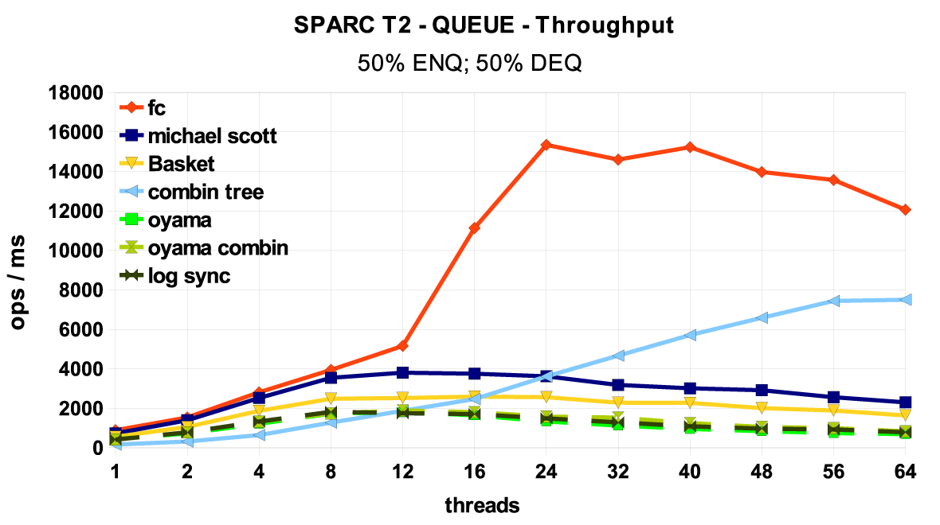
Linearizable FIFO Queue
Flat Combining
MS queue, Oyama,
and Log-Synch
Combining tree

Slide 265
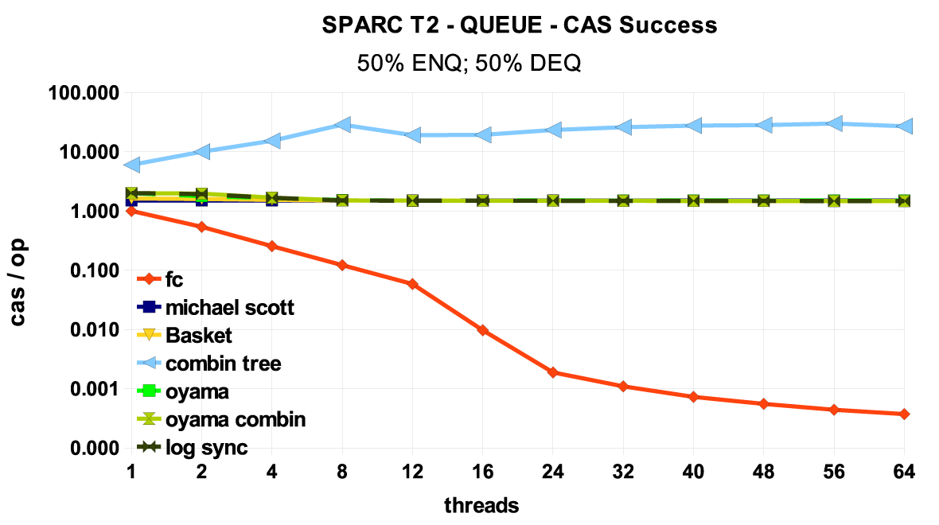
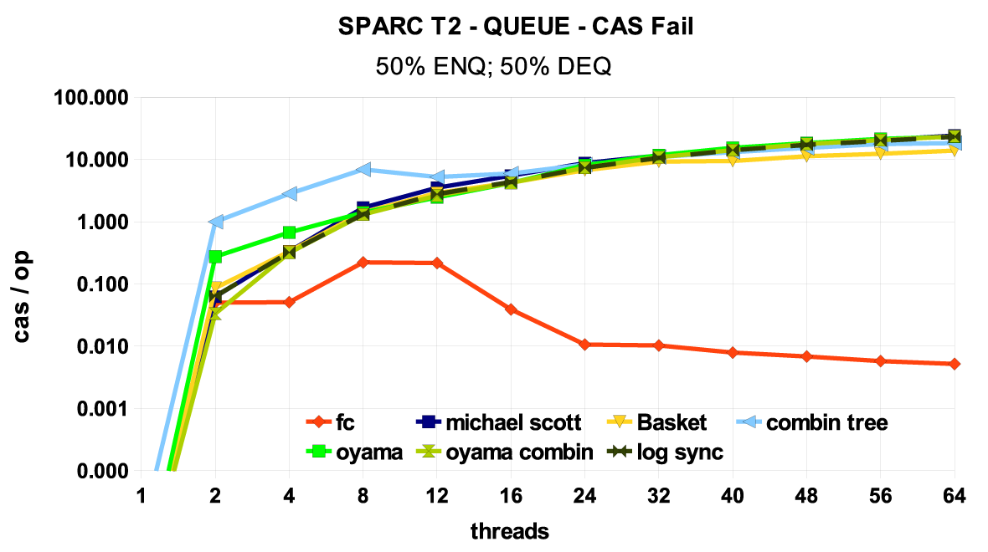
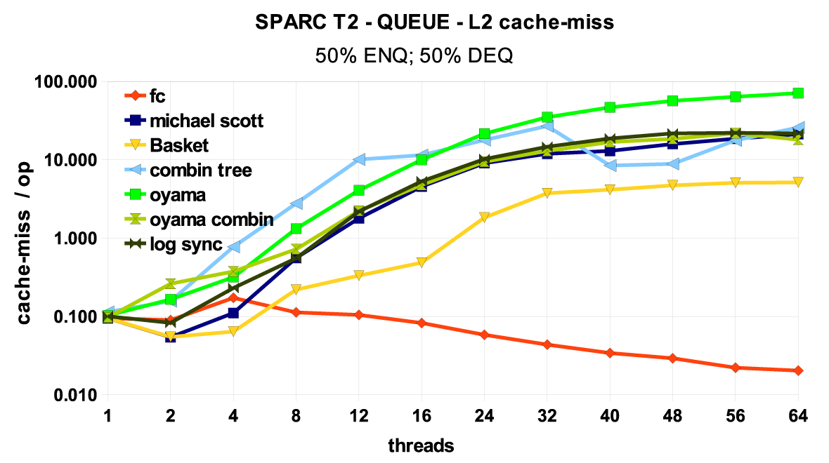
Benefits of Flat Combining
Flat Combining in Red

Slide 266
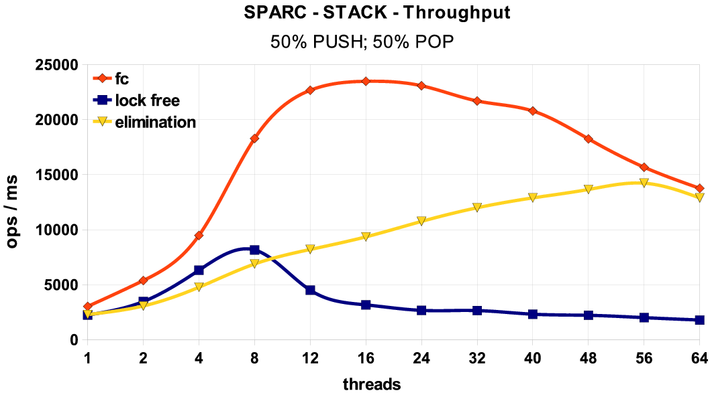
Linearizable Stack
Flat Combining
Elimination Stack
Treiber Lock-free Stack

Slide 267
Concurrent Priority Queue
(Chapter 15)
k deleteMin operations take O(k*log n)
1
deleteMin() traverses CASing until you manage to mark a node,
then use skiplist remove your marked node

Slide 268
Flat-Combining Priority Queue
cvccc
object
lock
counter
54
Head
CAS()
Publication list
Deq()
54
Enq(b)
12
Enq(b)
54
Deq()
Enq(a)
Enq(b)

Slide 269
Flat Combining Priority Queue
k deleteMin operations take O(k+log n)
Collect k deleteMin requests
Traverse skiplist towards kth key,
removing all nodes below your
path
Remove
traverse to find kth key, collect values to be returned

Slide 270
Priority Queue
Whats this?
Flat Combining Skiplist based queue
lock-based SkipQueue
lock-free SkipQueue

Slide 271
Priority Queue
Flat combining with sequential pairing heap plugged in…

Slide 272
Priority Queue on Intel
Flat combining with sequential pairing heap plugged in…

Slide 273
Don’t be Afraid of the Big Bad Lock
Fine grained parallelism comes with an overhead…not always worth the effort.
Sometimes using a single global lock is a win.

Slide 274
This work is licensed under a Creative Commons Attribution-ShareAlike 2.5 License.
You are free:
  to Share — to copy, distribute and transmit the work
  to Remix — to adapt the work
Under the following conditions:
  Attribution. You must attribute the work to “The Art of Multiprocessor Programming” (but not in any way that suggests that the authors endorse you or your use of the work).
  Share Alike. If you alter, transform, or build upon this work, you may distribute the resulting work only under the same, similar or a compatible license.
For any reuse or distribution, you must make clear to others the license terms of this work. The best way to do this is with a link to
  http://creativecommons.org/licenses/by-sa/3.0/.
Any of the above conditions can be waived if you get permission from the copyright holder.
Nothing in this license impairs or restricts the author's moral rights.

